Slide 1


Slide 2
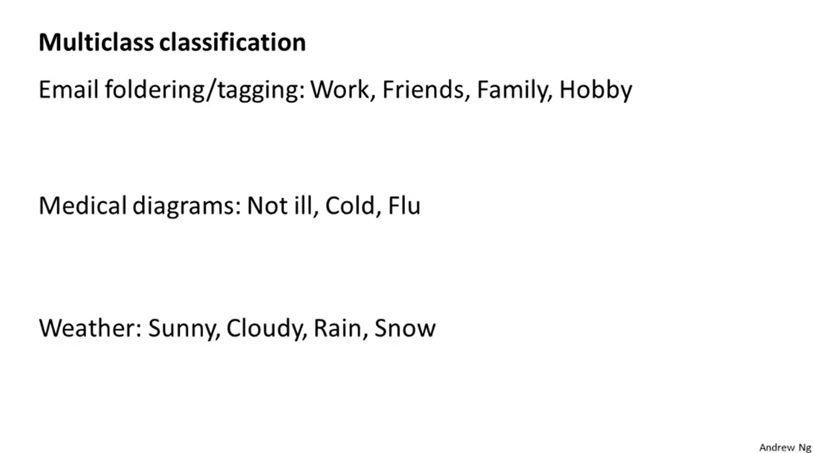

Slide 3
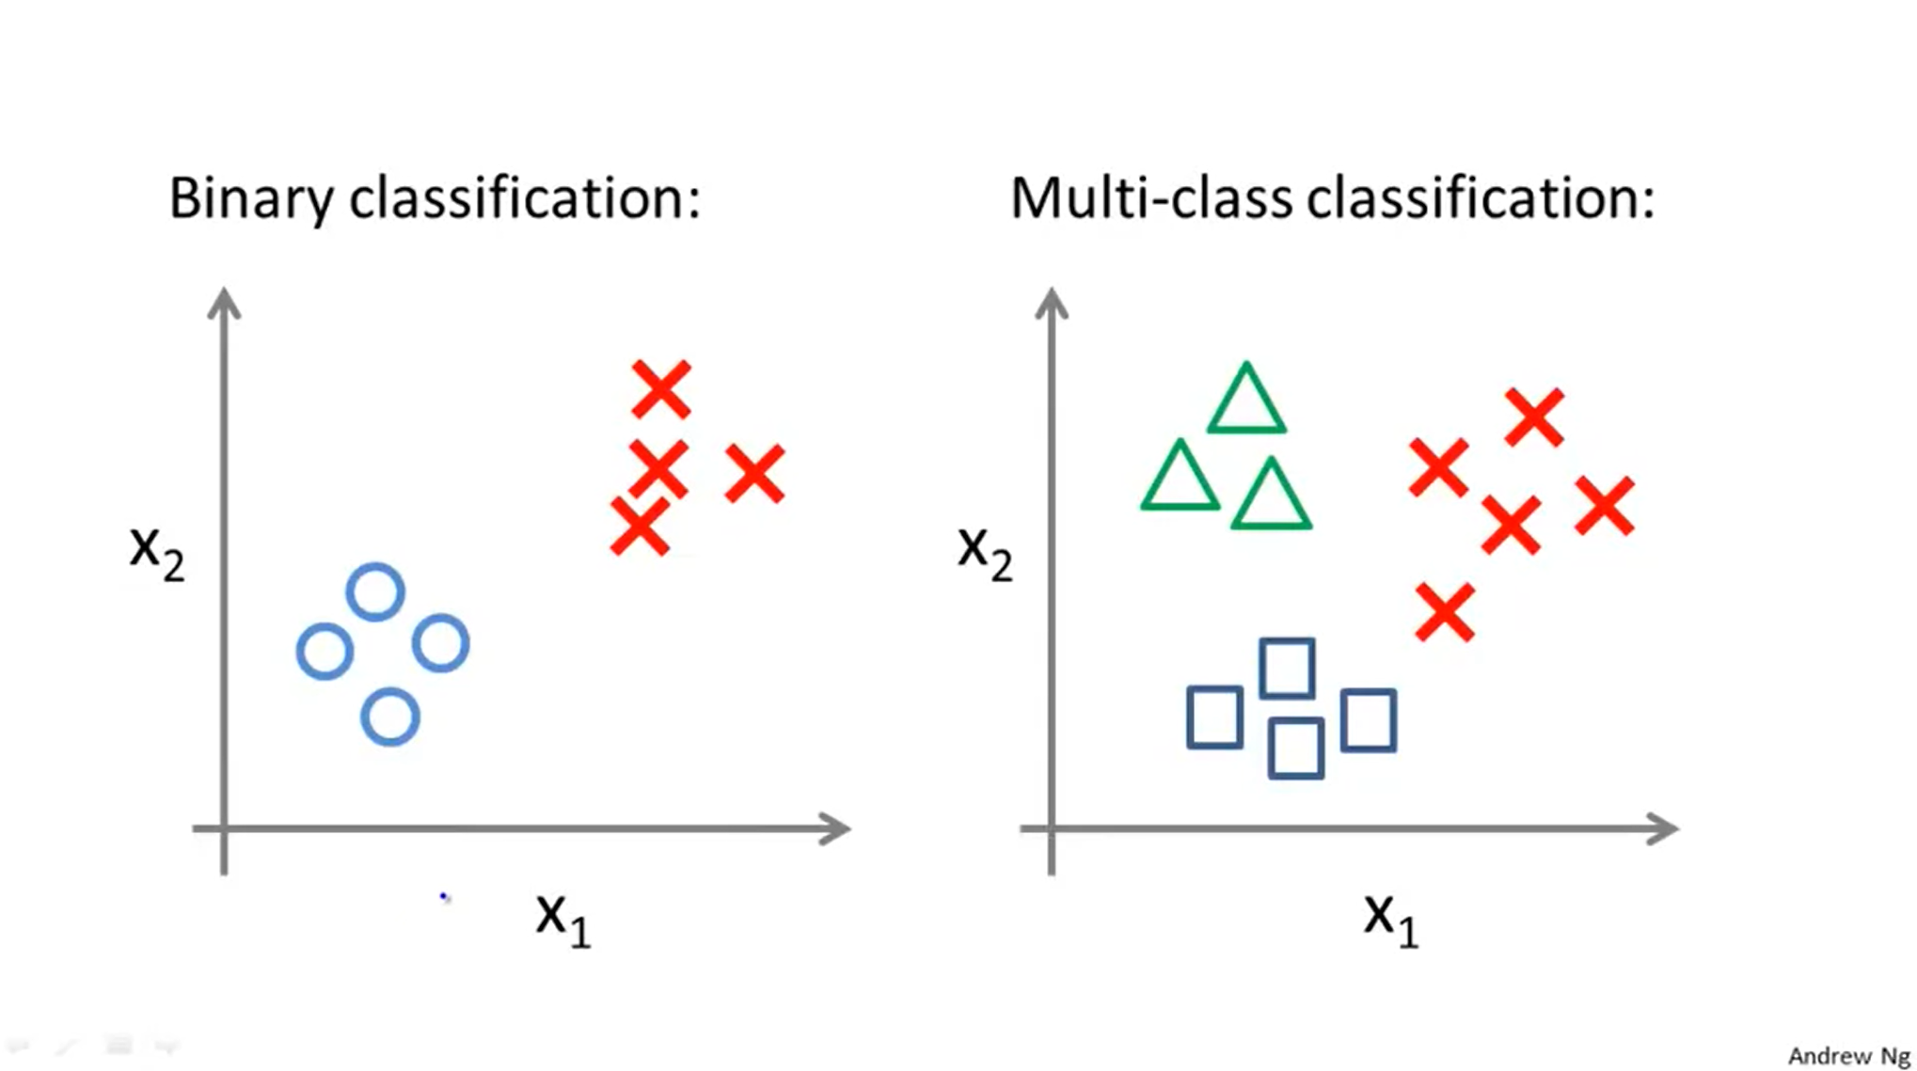

Slide 4
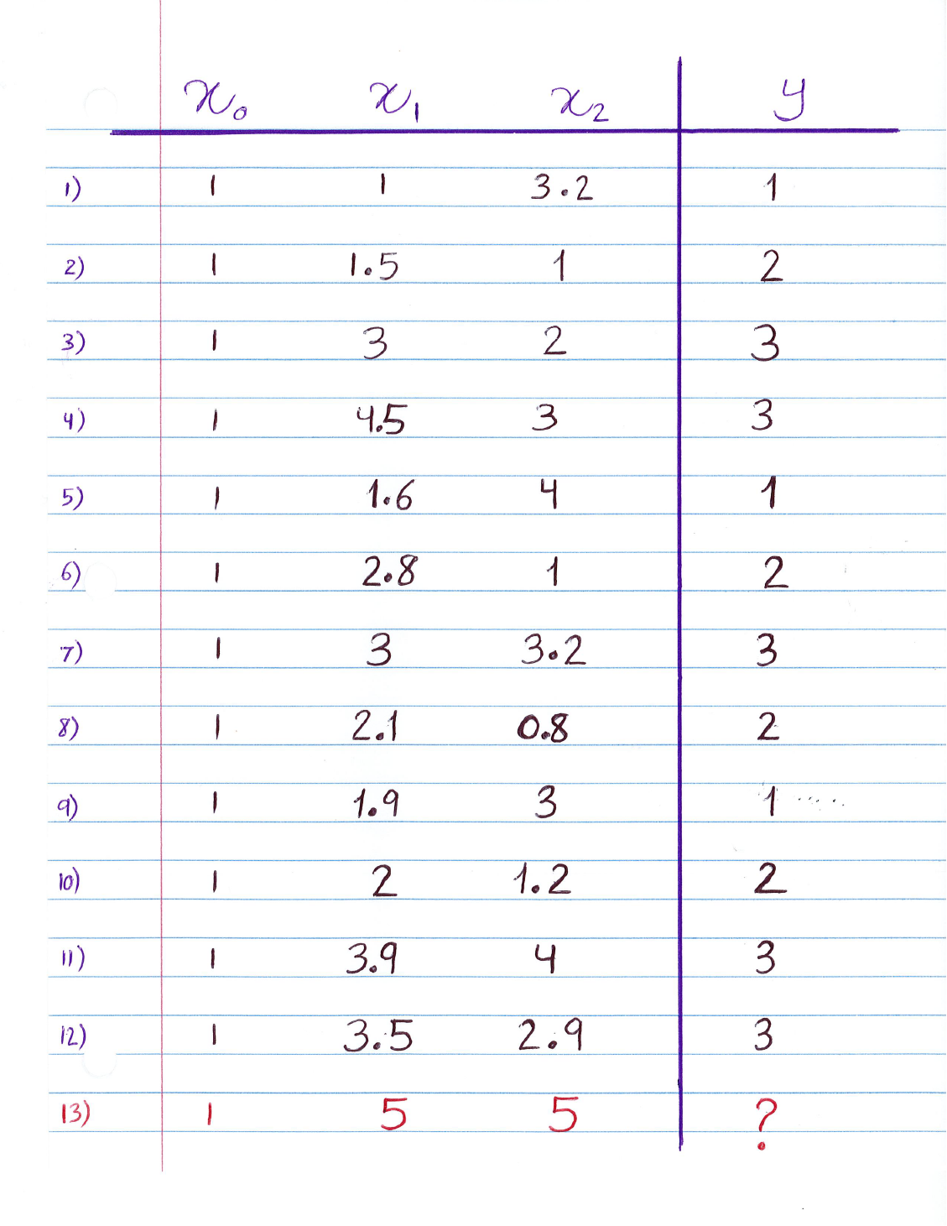

Slide 5
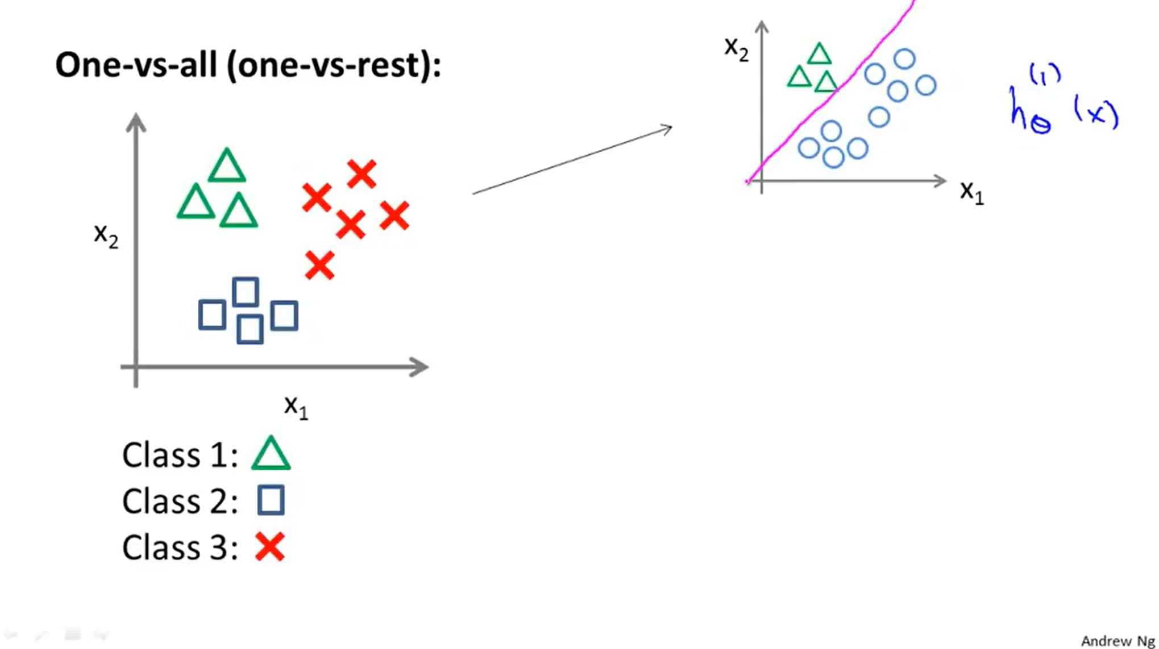
Ɵ0 = 22.2
Ɵ1 = -87.7
Ɵ2 = 60.4

Slide 6
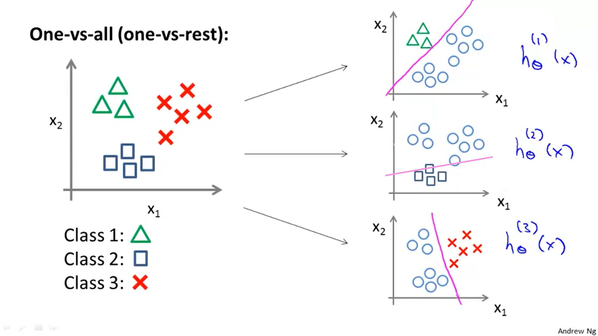
Ɵ0 = 22.2
Ɵ1 = -87.7
Ɵ2 = 60.4
Ɵ0 = 313.1
Ɵ1 = -43.5
Ɵ2 = -154.5
Ɵ0 = -408.4
Ɵ1 = 116.9
Ɵ2 = 46.3

Slide 7
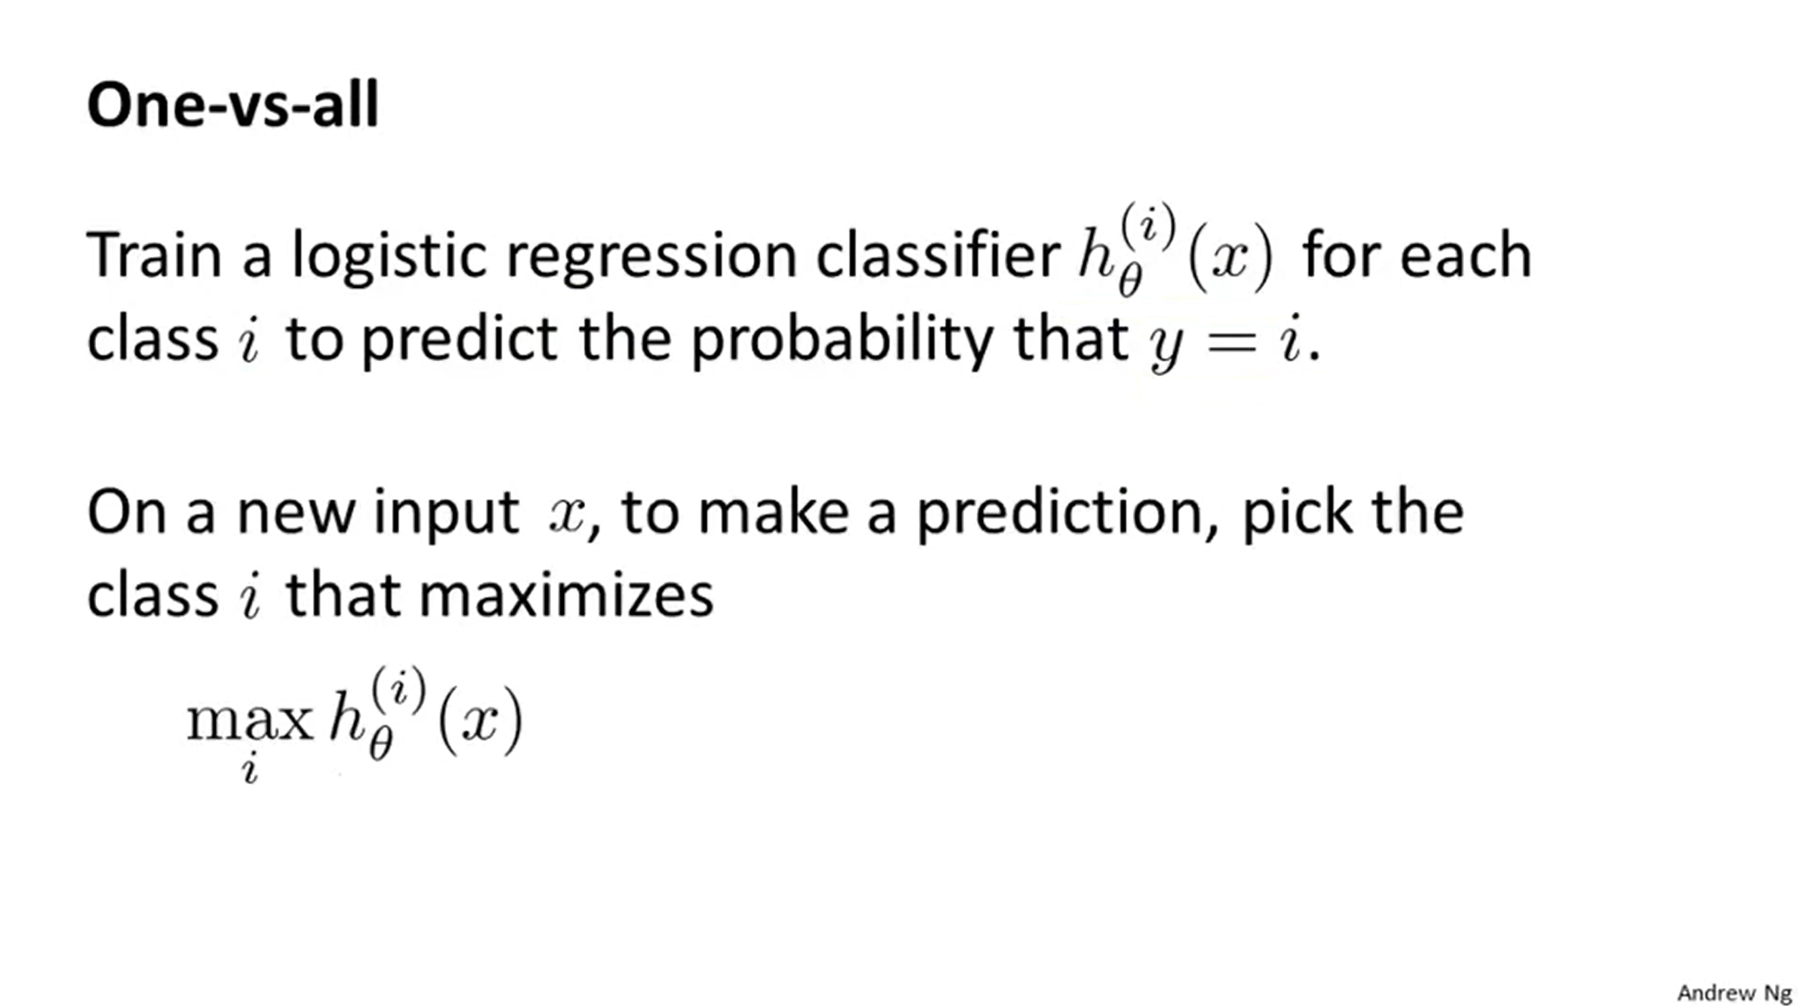

Slide 8
